Slide 1

THE lunch which matters

Slide 2
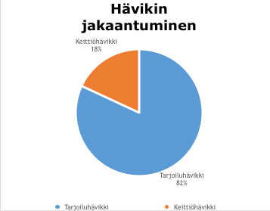
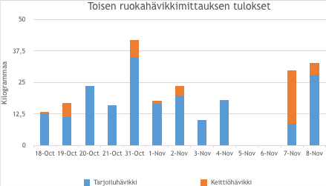
There is a Problem!

Slide 3

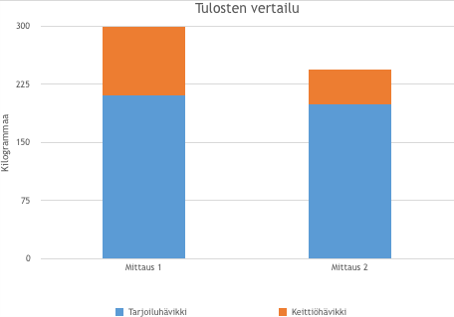
oVER 200kg of food is wasted every TWO WeekS!

Slide 4

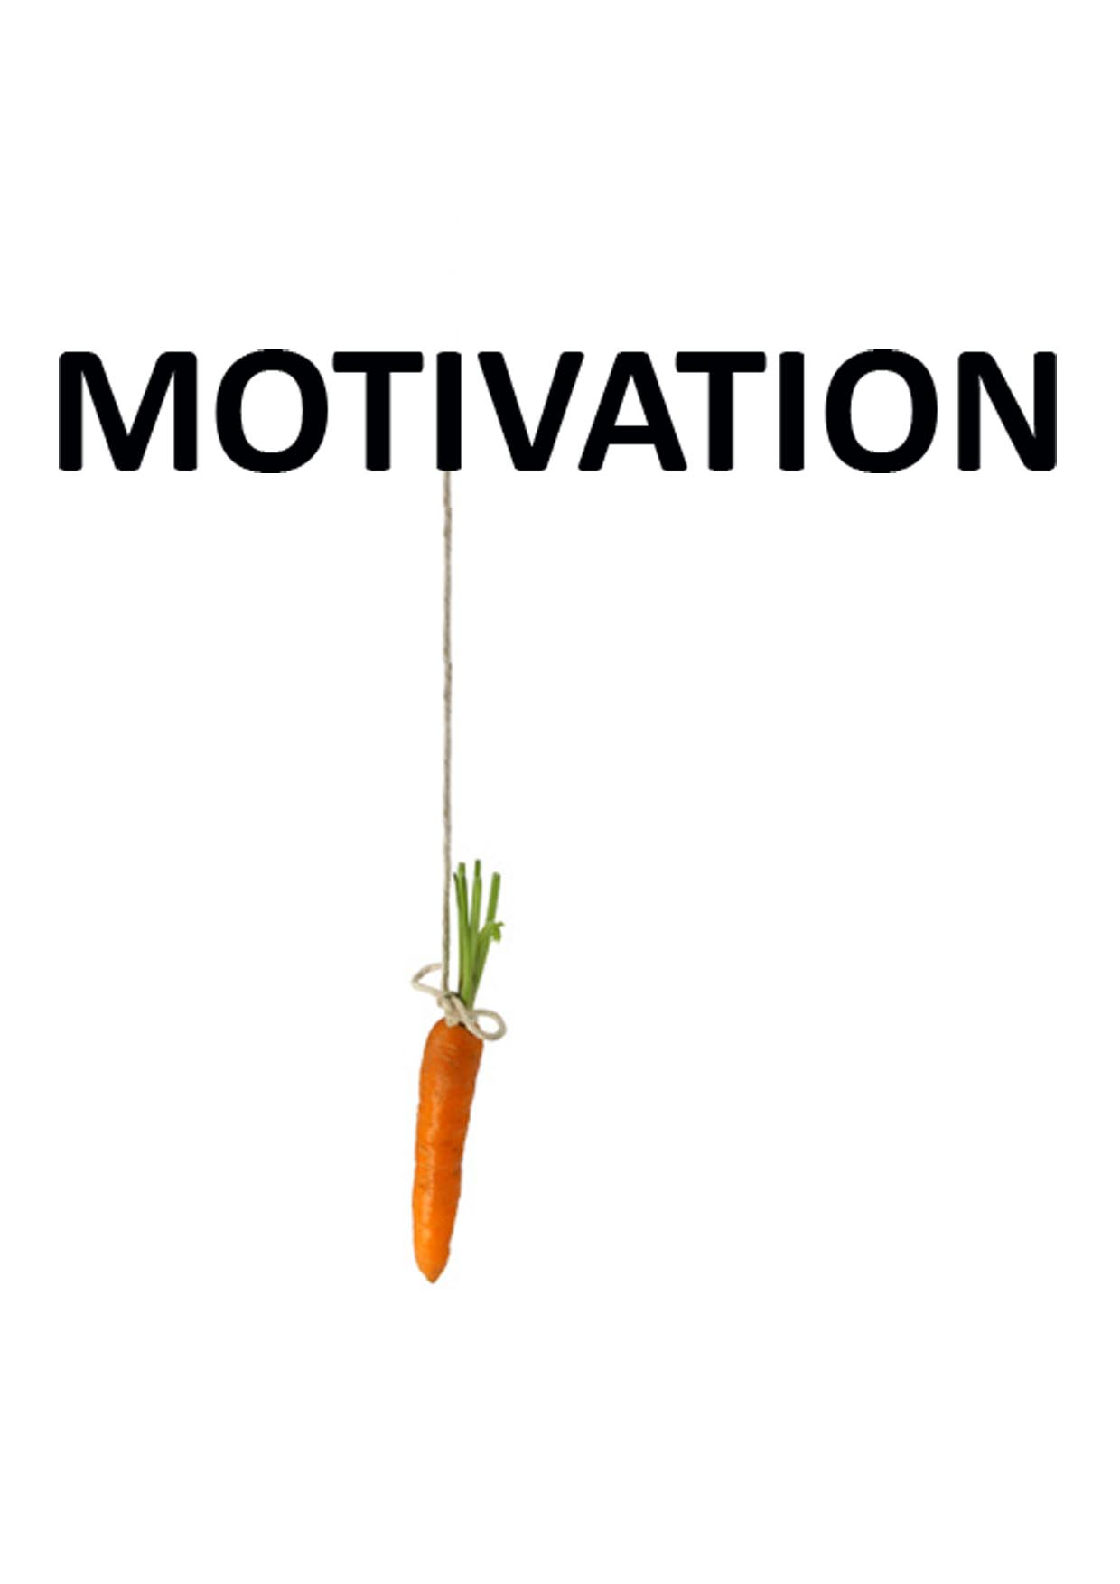
how to motivate people to reduce waste?

Slide 5

Solution
Extend Smartmeal
Gamify experience

Slide 6
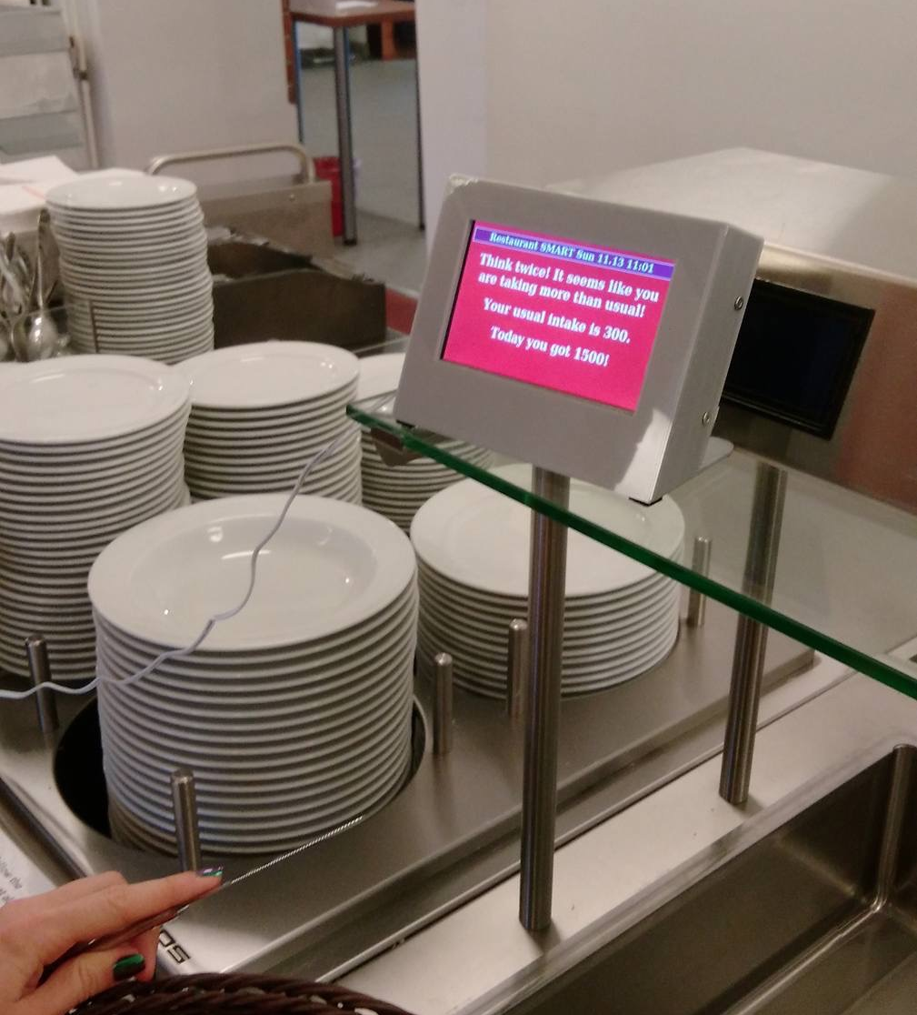
Extend Smartmeal
Weight the waste of each portion
Calculate users average portion
Alert when exceeding standard portion size

Slide 7
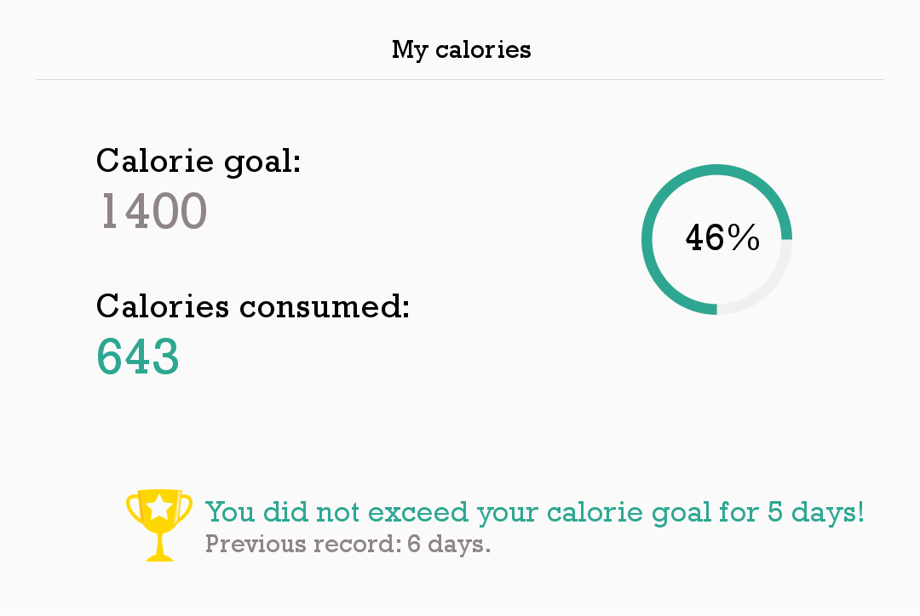
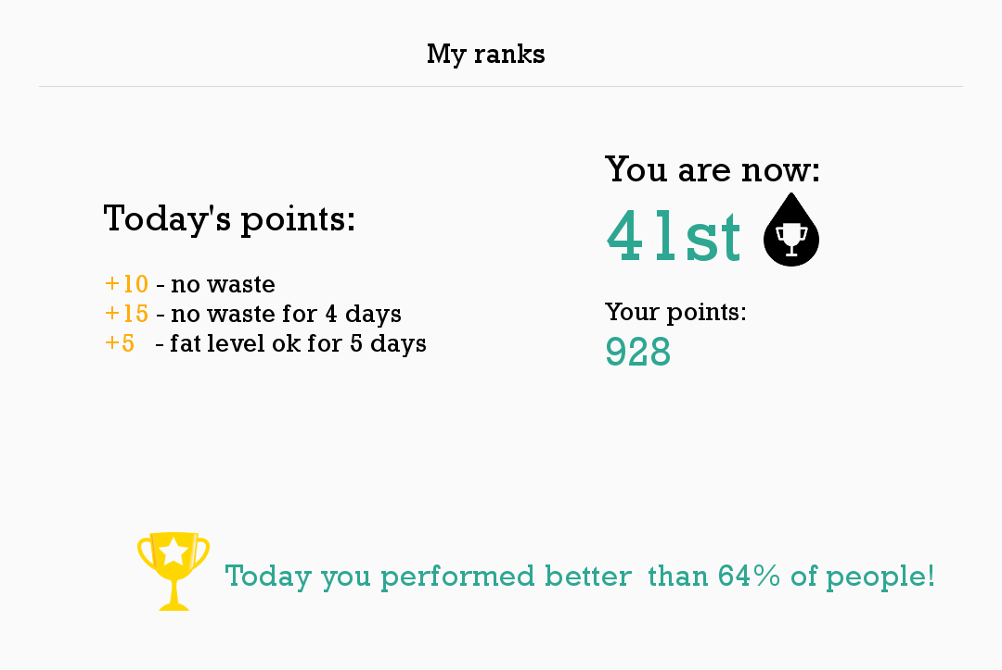
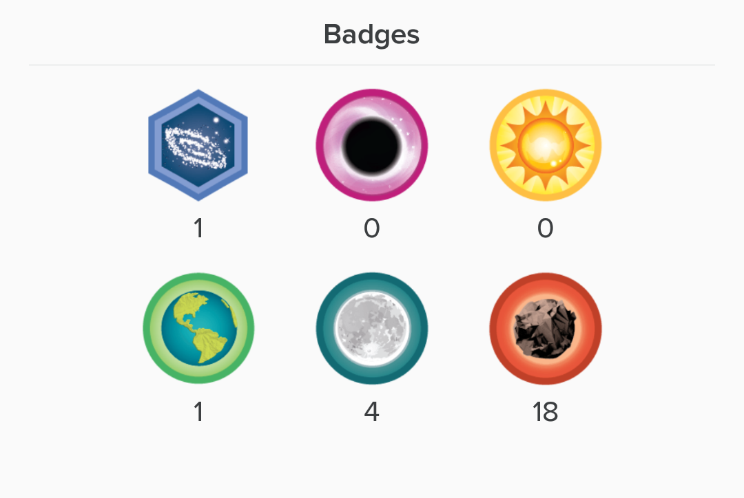
Gamify
Earn points by producing minimal waste and calories
Redeem points for rewards
Compete with others
View your eating history

Slide 8
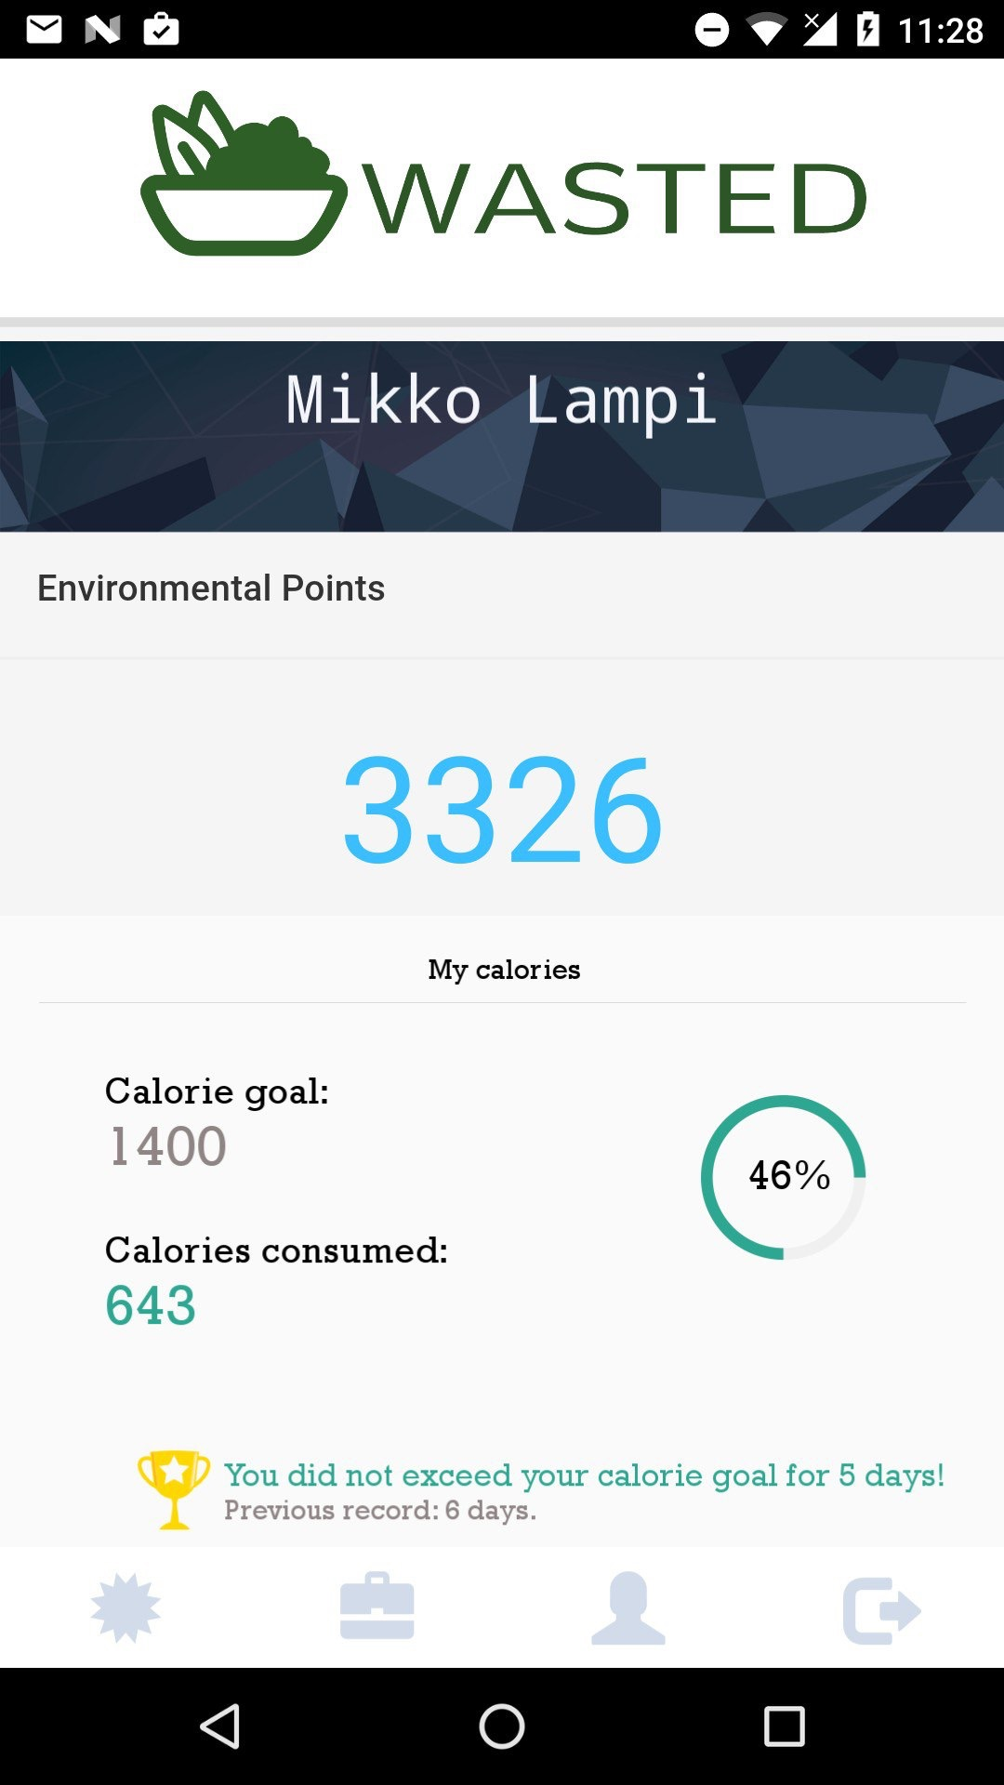
Demo

Slide 9




Be Responsible GET Wasted

